Slide 1
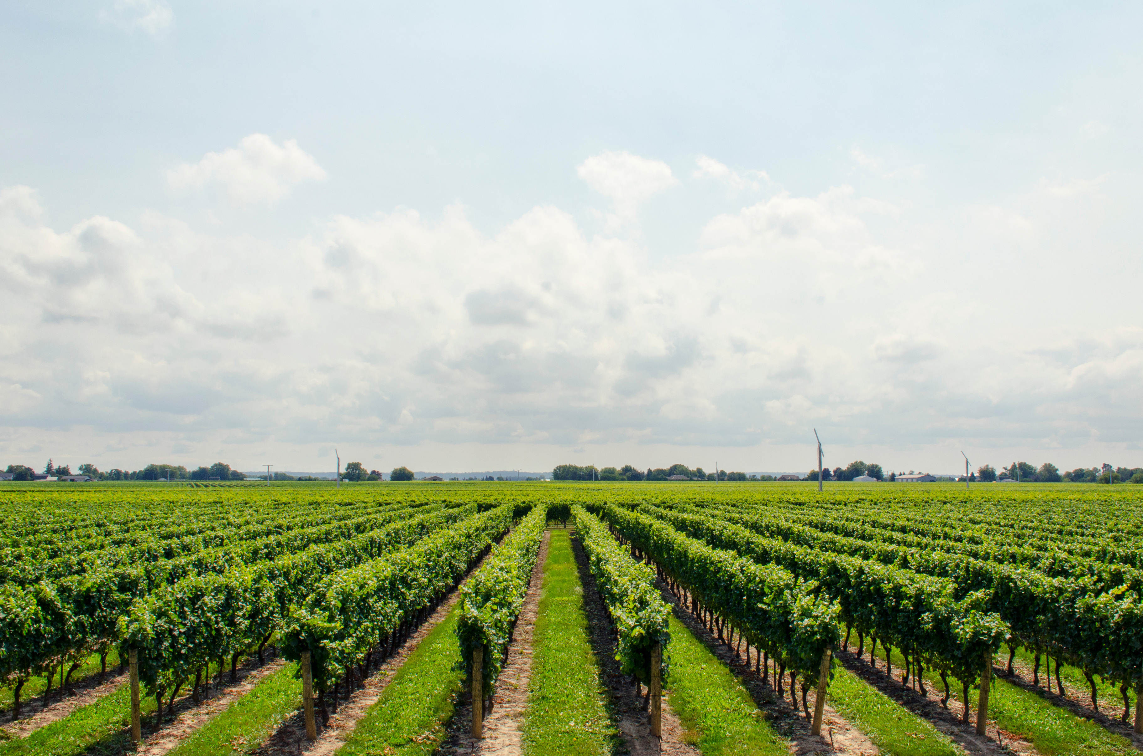


`
SMART IRRIGATION SYSTEM
Thousands Have Lived Without Love, But Not One Without Water
BE-A-56 SHUBHAM PATHAK
BE-A-51 SARVESH PANDEY
BE-A-45 ROHAN MISHRA
BE-A-60 ROSHAN PRAJAPATI

Slide 2
Report Outline:
PART 1 PROBLEMS.
PART 2
SOLUTION.
PART 3
3.1 ) HOW IT WORKS, 3.2 )PRODUCT 3.3 ) COMPONENTS, 3.4) GRAPH.
PART 4
USER BENEFITS.
PART 5
MODIFICATIONS.
PART 6
CONCLUSION.

Slide 3
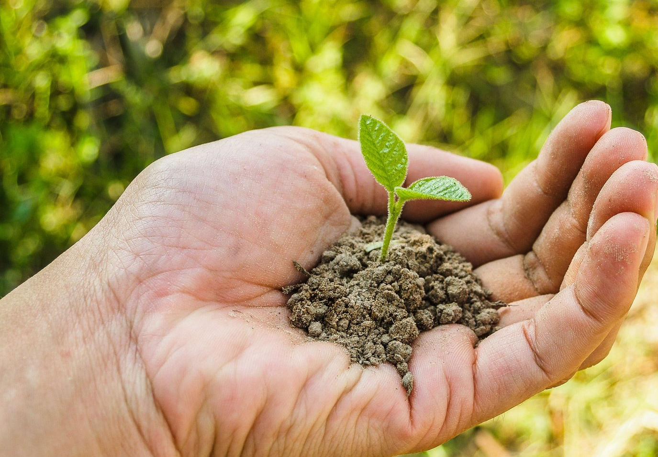
Problems:
Drawbacks of Traditional irrigation method:
Due to seepage in drains, wastage of water is caused.
Due to excess watering, water logging occurs .
Increase in labour need and electricity cost.
Promotes soil erosion.
Crop yielding is not upto the mark.
Water scarcity problem in arid and semi-arid zones.
Lacking water management system.

Slide 4
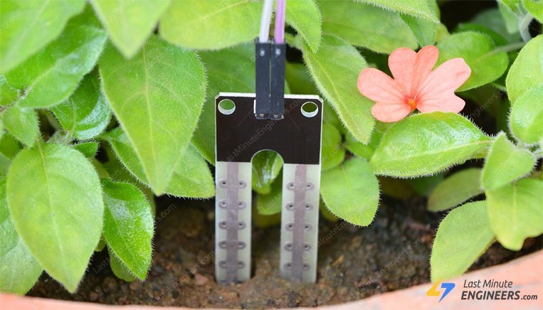
Solution:
Smart irrigation using soil moisture sensor & Arduino UNO
Smart Farming (AGRITECH)
Smart irrigation has different categories. It is used after doing a thorough Research & Inspection of previous data about land.
Smart irrigation represents approach to agricultural innovation in the whole by adopting smart technologies like moisture sensor and Arduino UNO.
“Smart irrigation using soil moisture sensor & Arduino UNO”

Slide 5
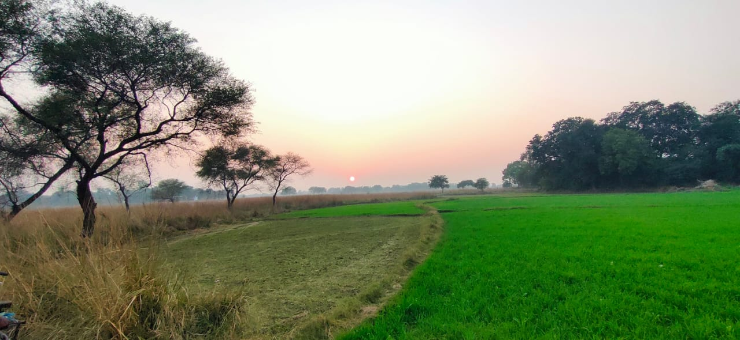
How It works:
In this system we are using Arduino microcontroller to control & sense the things in the project which include soil moisture sensor. The soil moisture is a sensor which varies when it comes in the contact of the moisture.
Basically it is a resistor that works on moisture condition when the moisture is more the resistance will decrease & when the moisture is less then the resistance will increase.
So we are going to assume or calibrate the value of sensor by putting it into different moisturizing condition of water.
After all the analysis part we are going to put the value in the code. We are going to put the value in the condition of the code.
So eventually if condition of our code will beside whether to start the pump or not.

Slide 6
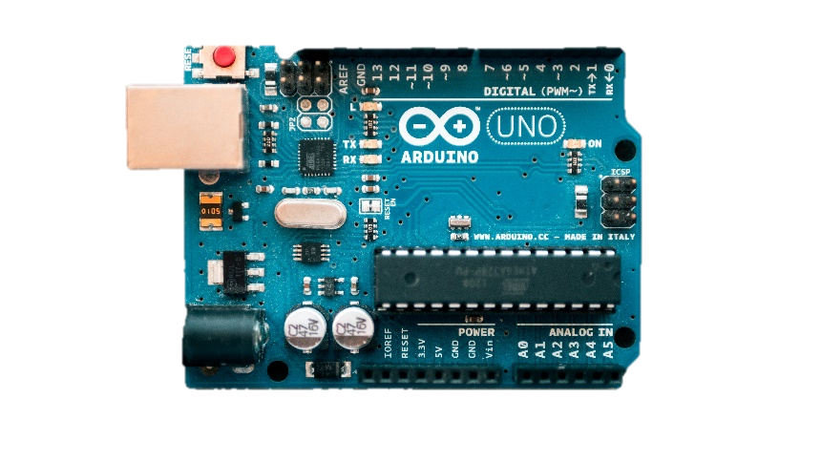
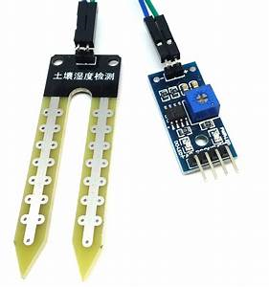
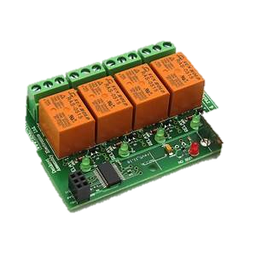
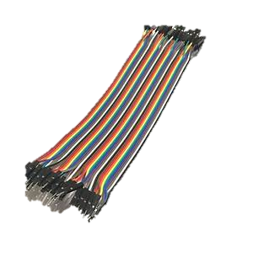
Components :
Depending on our method we have prepared a Arduino based soil moisture sensor (SMS).
The following are its Components:
Component :
Application :
DATA / OUTCOME
Used to supply power to the board and it acts as a serial device to connect the board to a computer system.
Arduino uno (with USB)
Our irrigation will execute the task as oriented in the computer program.
Soil sensor (probe)
The probe measures the volumetric water content in the soil.
The water content value will be prompted to the Arduino and necessary actions will be taken as per the requirement.
Four relay board, jumper wires (m/f) and jumper wires (f/f) .
The following components are used in connecting the Arduino and the Sensor(Probe).
The system will perform the execution with the help of the connecting components.

Slide 7
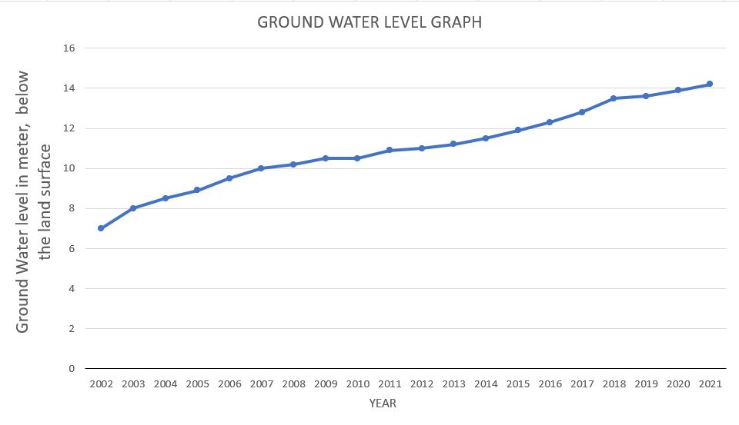
Groundwater Level Graph:
From The Graph We Currently Notice That The Water Availability Is In Stress. If This Rate Continues, Then We Would Face Severe Water Scarcity. So There Is An Urgent Need To Conserve Water.

Slide 8
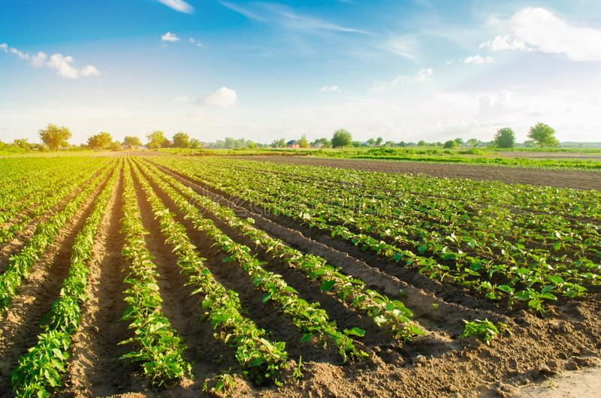
USER BENEFITES:
1
COST EFFECTIVE
2
OPTIMIZATION OF WATER
3
REDUCE MAN POWER
LONG TERM ENHANCED LANDSCAPE HEALTH
Make Maintaining Your Yard Easy And Convenient
4
5

Slide 9
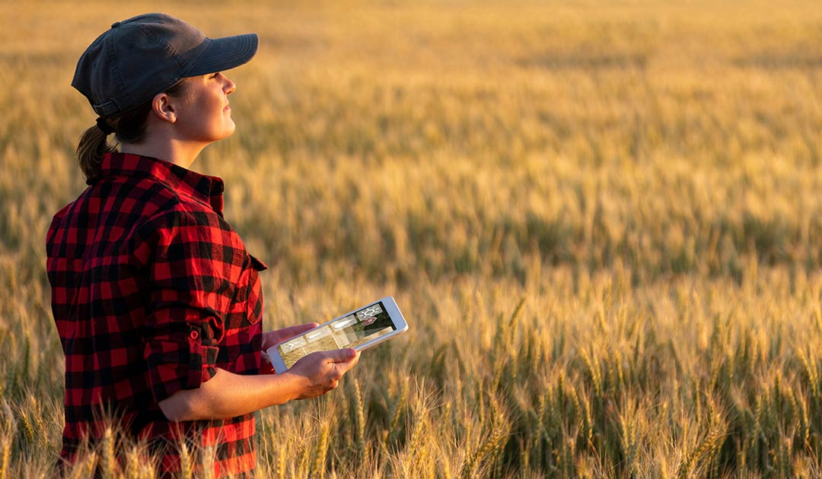
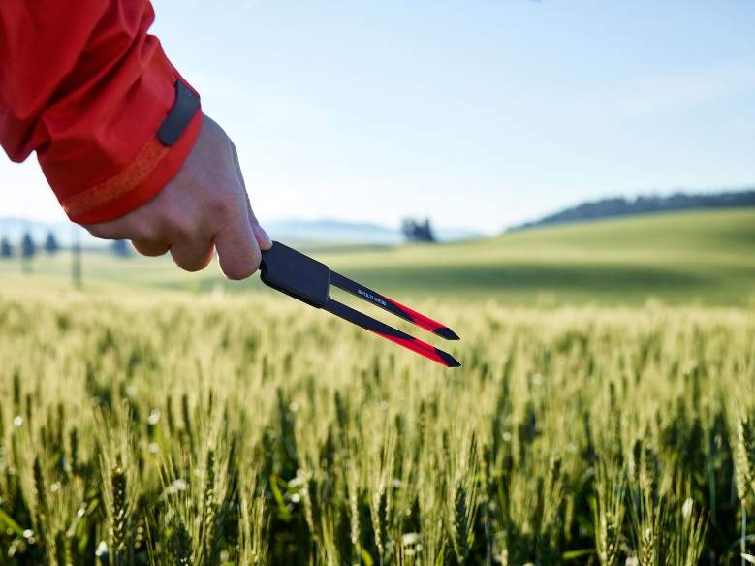
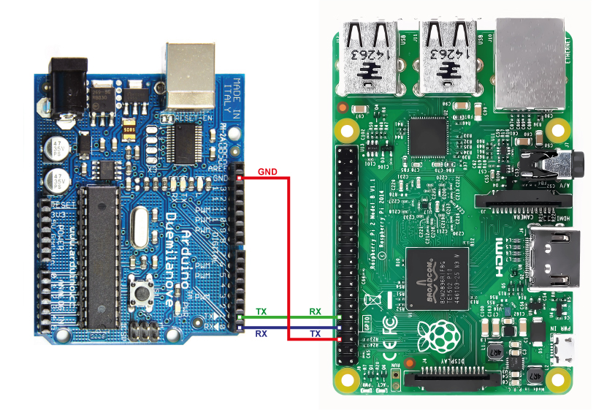
SOIL MOISTURE SENSORS
Updated Technology:
ARDUINO OVER RASPBERRY Pi2

Slide 10


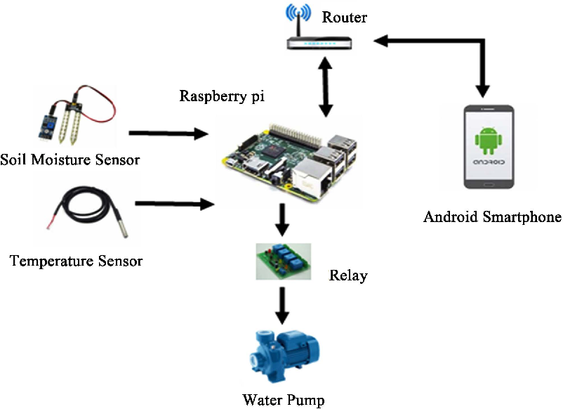

Conclusion.
By using this SMART IRRIGATION SYSTEM it optimizes the usage of water
by reducing wastage and reduce the human intervention for farmers.
This irrigation system allows cultivation in places with water scarcity thereby improving sustainability.
These are connected to smartphone or computer’s web page and farmer can operate them any time and any where.
Cost effective for optimizing water resources for agricultural production.

Slide 11

Thank You
SHUBHAM PATHAK BE-A- 56
shivam286088@gmail.com 8879458198
SARVESH PANDEY BE-A-51
Sarveshpandey556@gmail.com 8208876917
ROSHAN PRAJAPATI BE-A-60 roshanprajapatiabc@gmail.com 7710825714
ROHAN MISHRA BE-A-45 rohanmishra961@gmail.com 8422006609

